Slide 1


T

Slide 2


INTRODUCTION
In today’s digital world, most customers compare products online before making a purchase.
E-commerce websites contain huge amounts of valuable product information such as prices, features, ratings, and reviews.
However, collecting this data manually is time-consuming and inefficient.
This project focuses on automatically extracting washing
machine product data from websites using Python-based web scraping techniques.
The collected data is stored in an Excel file and used for analysis.

Slide 3

PROBLEM STATEMENT
Washing machine details such as price, features, ratings, and reviews are available online but spread across different e-commerce platforms, making comparison difficult
Collecting washing machine specifications and prices manually requires a lot of time and effort, especially when dealing with many products.
Website data is presented in HTML format, which is not directly suitable for analysis without processing and structuring.
Without organized datasets, it is hard to identify price trends, popular brands, or commonly preferred washing machine features.
An automated system is required to regularly collect, update, and store washing machine data efficiently for analysis and decision-making.

Slide 4
OBJECTIVES
To automatically extract washing machine product details from e-commerce websites using Python.
To transform website HTML content into organized tabular data.
To develop a web scraping program that can be reused for different products
To save the scraped washing machine data into an Excel file.
To study pricing patterns, brand popularity, and feature trends of washing machines.
To provide useful insights that help customers or businesses make better decisions

Slide 5






LIBRARIES

Slide 6
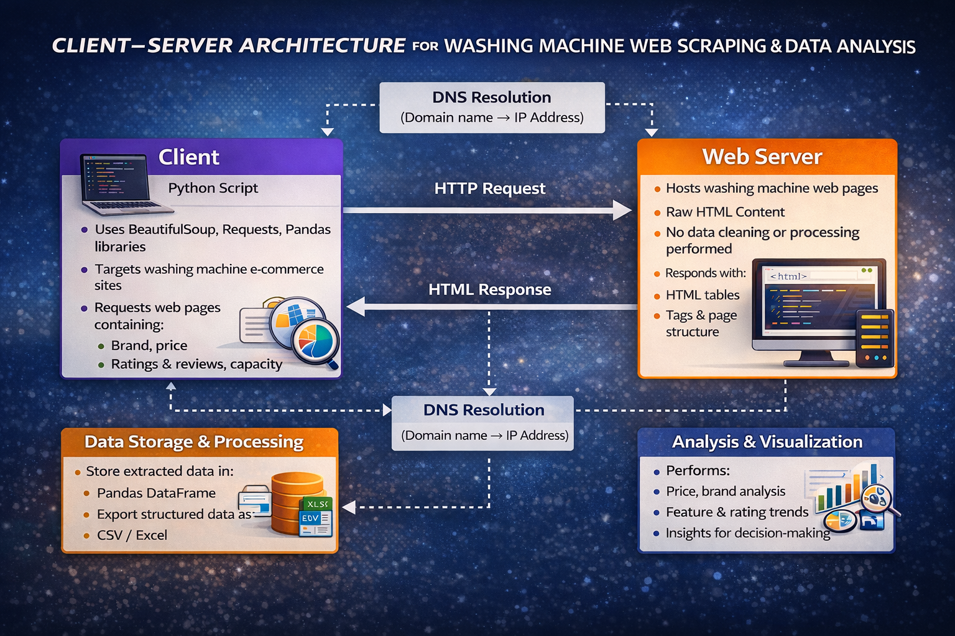

Slide 7
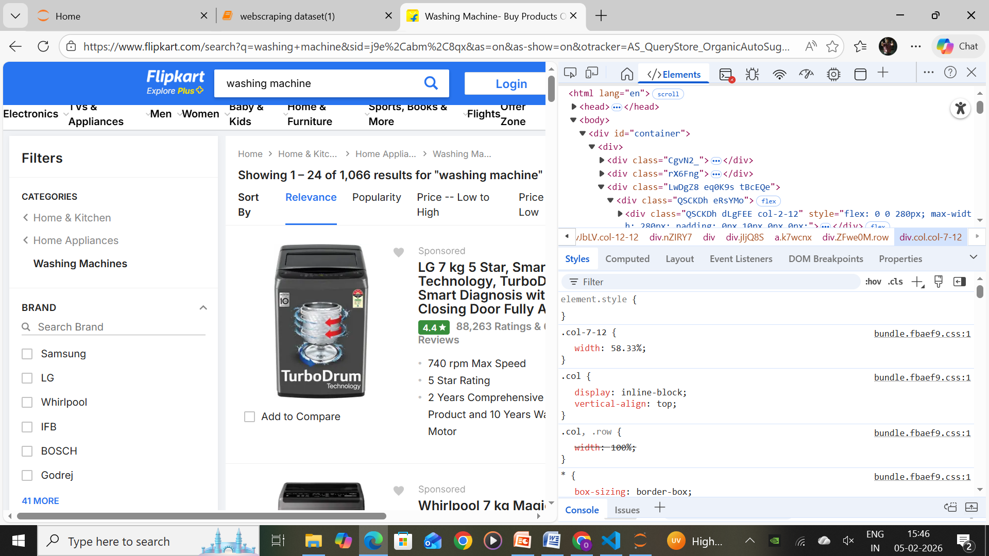
WEB SCRAPPING
The project targets an e-commerce search results page (e.g., Flipkart washing machine listings) that displays multiple products with details like price, rating, and specifications.
A Python script uses the requests library to send an HTTP GET request to the washing machine search results URL and retrieve the page’s HTML content
Using the browser’s Inspect/Developer Tools, we analyze the HTML structure to locate product containers, titles, prices, ratings, and feature sections using specific class names and tags.
With BeautifulSoup, the scraper extracts key information such as:
Product Name
Brand
Price
Ratings & Number of Reviews
Key Features (RPM, capacity, type, etc.)

Slide 8
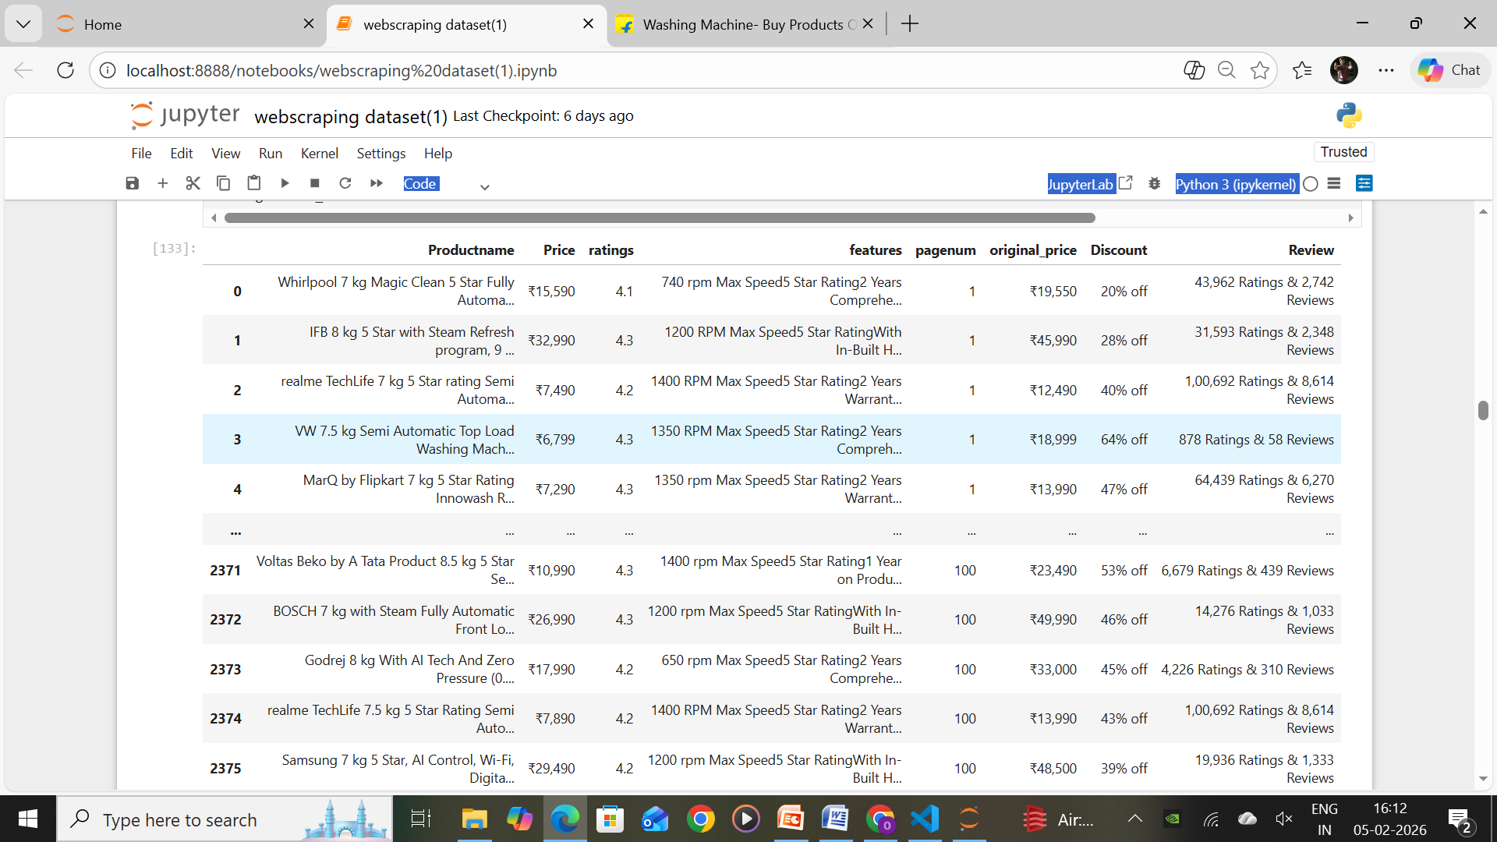
RAW DATASET

Slide 9
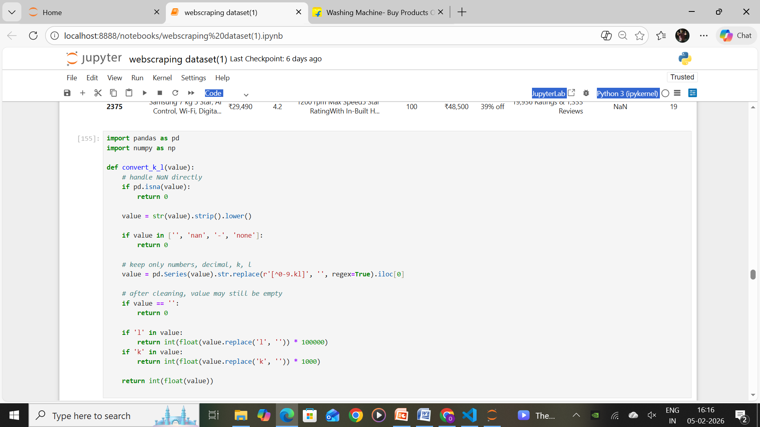
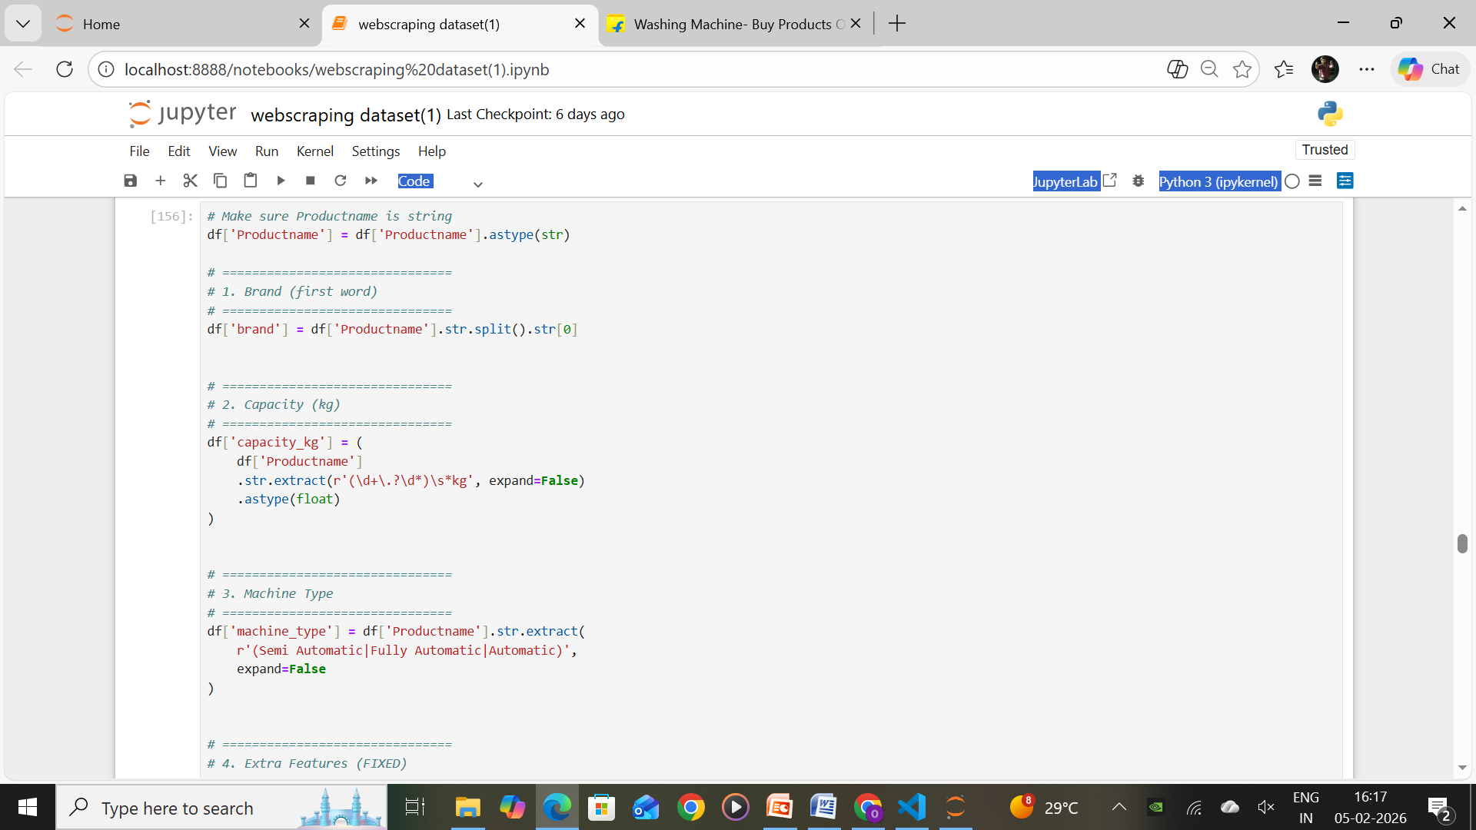
DATA CLEANING USING REGEX
Regex helps eliminate unwanted symbols like @, #, %, ₹, * from scraped text data, keeping only meaningful values
.
Prices, ratings, and weights often come with text (e.g., ₹24,999, 7 kg). Regex is used to extract only numbers for analysis.
Regex removes unnecessary spaces, tabs, and newlines that appear due to HTML scraping.
Scraped data may contain HTML elements (<div>, <span>). Regex is used to strip these tags and keep clean text.
Unnecessary words like “Sponsored”, “Offer”, or “Limited Deal” can be removed using regex-based matching.

Slide 10
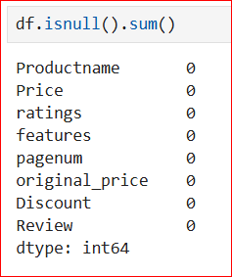
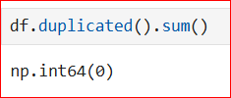
DATA CLEANING STEPS
The output shows 0 for all columns, which means there are no null or missing values in the dataset.
All important attributes such as Product name, Price, Ratings, Features, Reviews, etc., were successfully scraped without loss of information
Since there are no missing values, the dataset is more reliable and suitable for further analysis and visualization.
As null values are absent, there is no requirement for data imputation techniques like mean, median, or forward filling.
A null-free dataset can be directly used for price comparison, rating analysis, and trend identification.

Slide 11
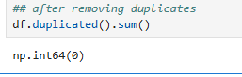
CHECKING NULL VALUES AND REMOVING DUPLICATE VALUES
Missing values were handled across all columns
No null values remain in the dataset
Duplicate records were identified earlier and removed
Dataset is clean, consistent, and analysis-ready
• No duplicate records are present in the dataset.
• This confirms each product is unique and reliable.
• Duplicate handling is not required before analysis.

Slide 12
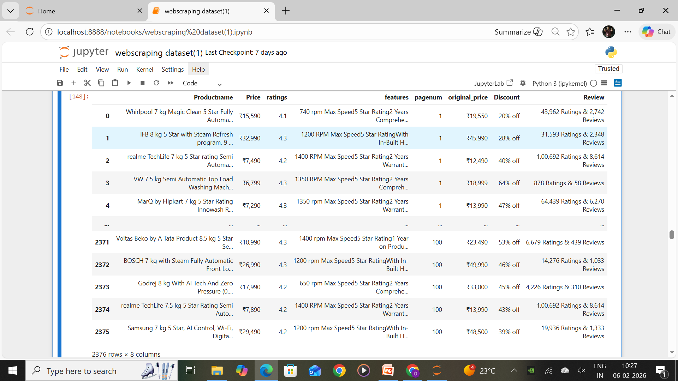
CLEANED DATASET

Slide 13
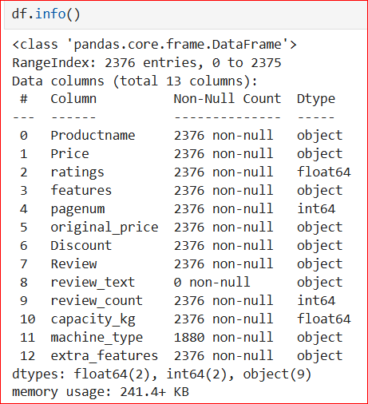
CHECK DATA STRUCTURE
The dataset contains 2376 records and 13 columns, providing a rich dataset for analysis.
There are no missing values in most columns, indicating good data quality.
The data includes a mix of numeric (price, ratings, capacity, review counts) and categorical features (product name, machine type, features, reviews).
Machine type has some missing values (1880 non-null), which may require data cleaning.
Overall, the dataset is well-structured and suitable for exploratory data analysis and modeling

Slide 14
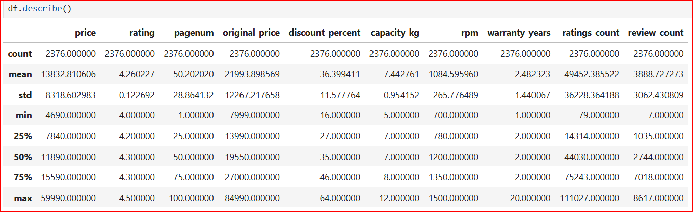
NUMERICAL DATA

Slide 15
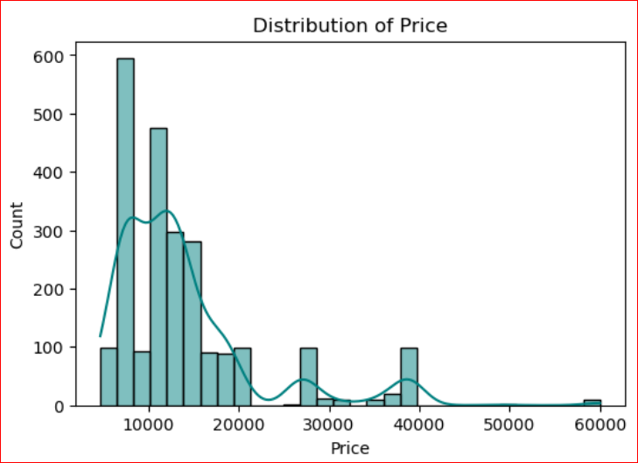
VISUALIZATION
UNIVARIANT ANALYSIS
Right-skewed distribution Most products are concentrated at lower price ranges
Majority of prices between ₹7,000 – ₹15,000 This range has the highest frequency, indicating it is the most common and affordable segment.
Peak around ₹9,000 – ₹12,000 The tallest bars and KDE peak suggest this is the dominant price bracket

Slide 16
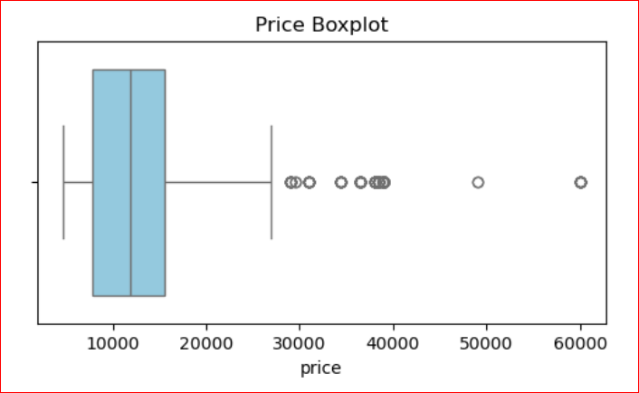
BOXPLOT
Median price ≈ ₹11,000, showing the typical product cost.
Most prices lie between ₹8,000 – ₹15,000, indicating a strong mid-range segment.
Right-skewed distribution with several high-price outliers.
Few premium products priced above ₹30,000 – ₹60,000.
Overall, the data shows high price variation with focus on affordable products.

Slide 17
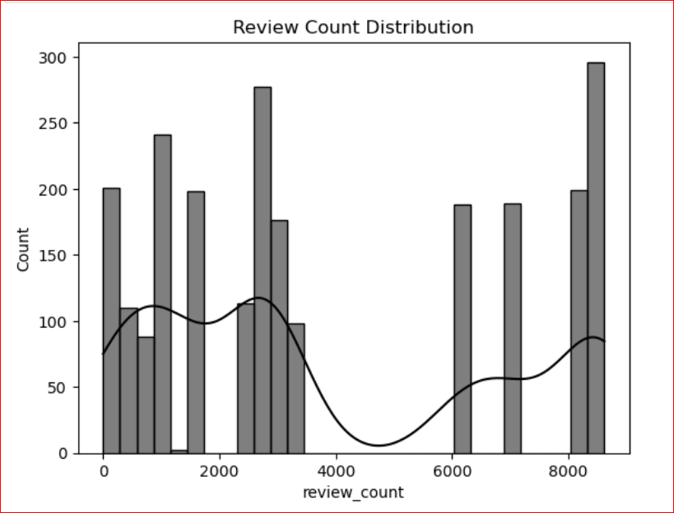
HIST PLOT
Most products have low to moderate reviews, mainly between 0 – 3,000.
Few products have very high review counts (6,000 – 8,500), indicating highly popular items.
The distribution is right-skewed, with a long tail towards higher values
Presence of peaks at multiple ranges suggests different popularity segments
Overall, only a small number of products receive very high customer engagement

Slide 18
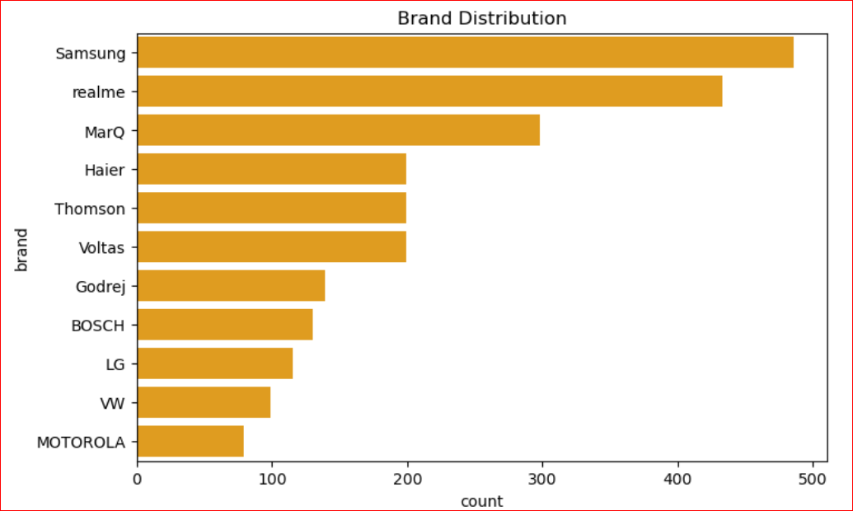
BAR PLOT
BIVARIANT ANALYSIS
Samsung has the highest number of products, leading the market.
realme is the second most frequent brand, close behind Samsung.
MarQ holds a strong third position with moderate presence.
Haier, Thomson, and Voltas show similar mid-range counts.
Godrej, BOSCH, and LG have lower but noticeable representation.
VW and Motorola have the least number of products in the dataset.

Slide 19
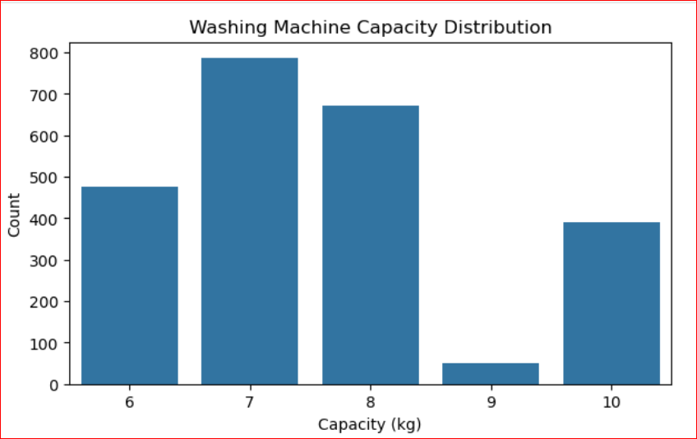
CAPACITY VS COUNT DISTUBUTION
7 kg capacity is the most common, showing highest demand.
8 kg is the second most popular capacity.
6 kg also has significant presence.
10 kg shows moderate demand.
9 kg capacity is the least common in the dataset.

Slide 20
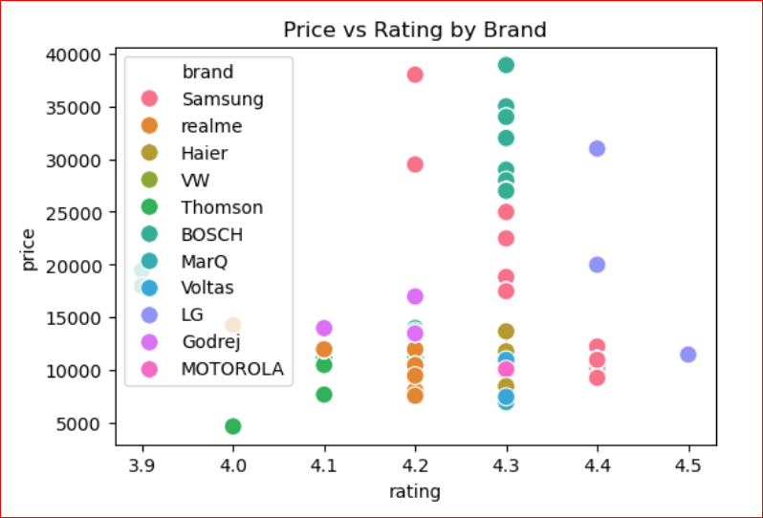
Most products have ratings between 4.0 and 4.4, showing overall good customer satisfaction.
Higher-priced models generally fall in the 4.2–4.4 rating range.
Samsung, BOSCH, and LG appear in the higher price segments.
realme, MarQ, and Godrej mostly offer budget-friendly options with good ratings.
No strong linear relationship is observed between price and rating.
PRICE VS RATING BY BRAND

Slide 21
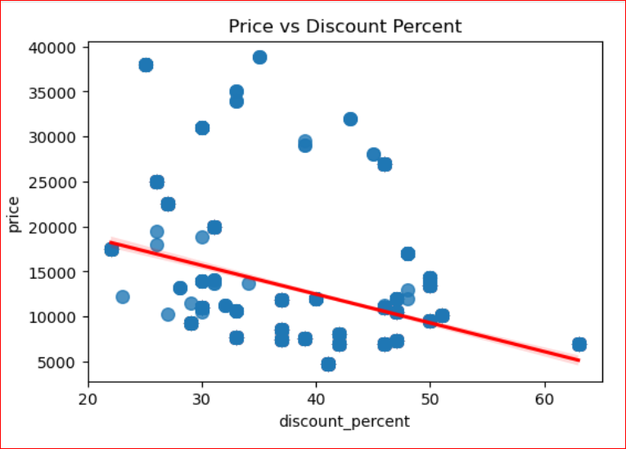
The graph shows a negative relationship between price and discount percentage.
Higher discounts are mostly offered on lower-priced products.
Lower discounts are generally seen on higher-priced items.
Most discounts fall in the 25%–50% range.
The trend line confirms an overall decreasing price with increasing discount
PRICE VS DISCOUNT PERCENT

Slide 22
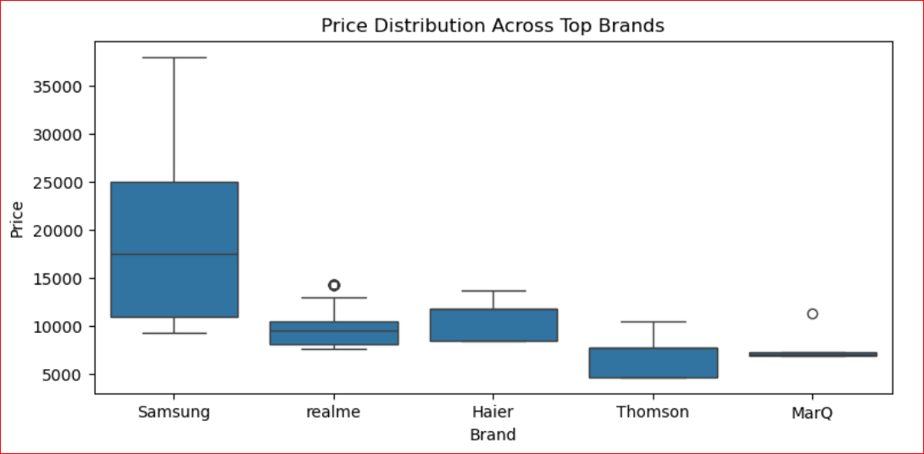
Samsung shows the widest price range and the highest median price, indicating premium products.
Haier has moderate pricing with a balanced price spread.
realme mainly falls in the budget to mid-range segment.
Thomson and MarQ are the most affordable brands with lower price ranges.
Overall, Samsung is the premium brand, while Thomson and MarQ target budget buyers.
PRICE DISTUBUTION ACROSS BRANDS

Slide 23
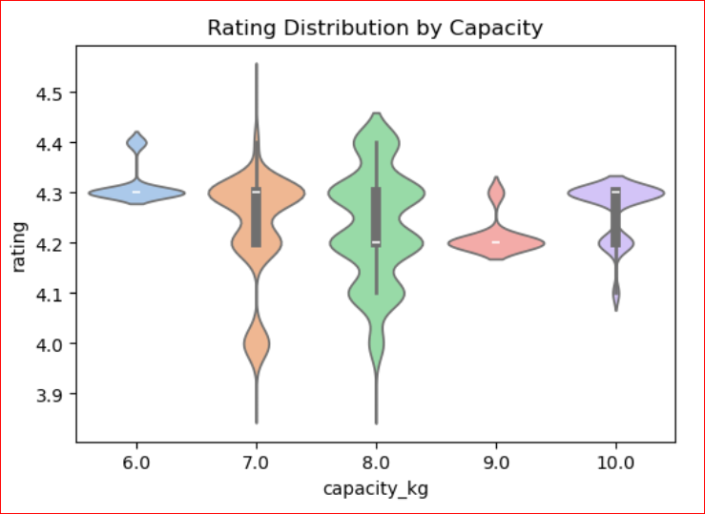
RATING DISTUBUTION BY CAPACITY
Ratings for all capacities mostly lie between 4.1 and 4.4, showing high customer satisfaction.
8 kg models show the widest rating spread, indicating varied user experiences.
6 kg and 10 kg capacities have more consistent ratings around 4.3
7 kg models show slight variability but remain highly rated.
9 kg capacity has stable ratings near 4.2.

Slide 24
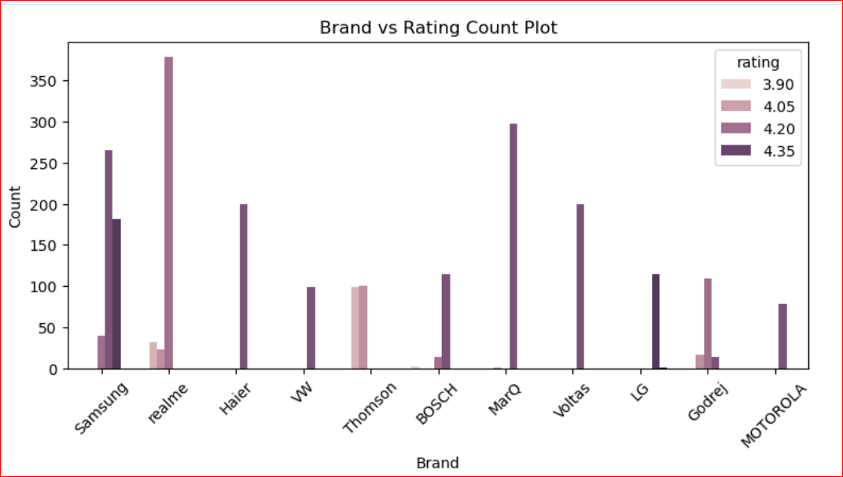
COUNT PLOT
Most brands have higher counts in the 4.20 and 4.35 rating ranges, indicating good overall customer satisfaction.
realme and Samsung show the highest number of highly-rated products.
MarQ and Voltas also have strong presence in higher ratings (4.35).
Thomson and VW have fewer products, mostly in the mid-rating range.
Motorola has the lowest number of rated products.

Slide 25
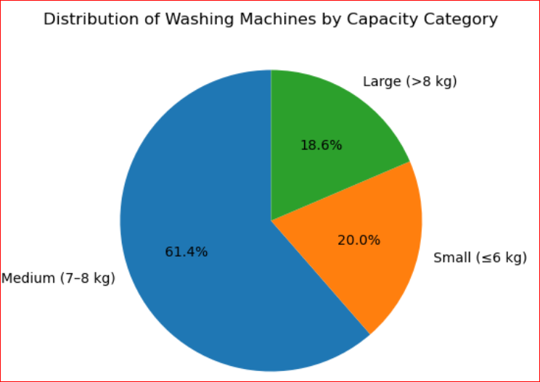
Medium capacity (7–8 kg) washing machines dominate the market with 61.4%, showing the highest demand.
Small capacity (≤6 kg) models account for 20%, suitable for small families or individuals.
Large capacity (>8 kg) machines make up 18.6%, preferred by large families or heavy usage.
Overall, medium-sized machines are the most popular choice among consumers.
PIE PLOT

Slide 26
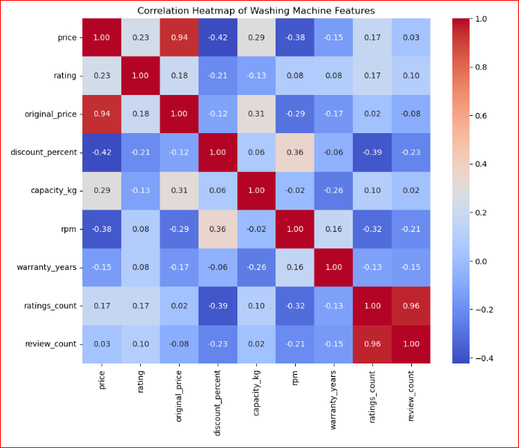
MULTIVARIATE PLOT
Price and Original Price show a very strong positive correlation (0.94), meaning they move together.
Discount % is negatively correlated with Price (-0.42), indicating higher discounts usually reduce the final price.
Capacity (kg) has a moderate positive relation with Price (0.29), so larger machines tend to cost more
RPM has a negative correlation with Price (-0.38), suggesting higher RPM models are not always more expensive.
Ratings Count and Review Count are highly correlated (0.96), showing that more ratings usually mean more reviews.
Overall, price is mainly influenced by original price, discount, and capacity.

Slide 27
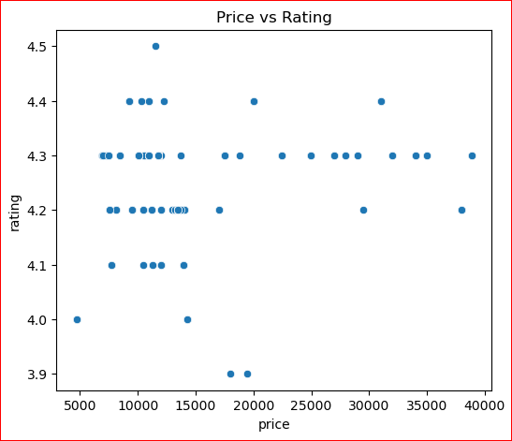
Ratings mostly lie between 4.1 and 4.4, showing generally good customer satisfaction.
No strong relationship between price and rating — higher price does not guarantee higher rating.
Mid-range priced models (₹8k–₹15k) have ratings similar to expensive models.
Most products cluster around 4.2–4.3 ratings, indicating consistent quality across price ranges.
Conclusion: Customers value performance and features more than just price.
PRICE VS RATING

Slide 28
CONCLUSION
The web scraping project successfully collected large-scale real-world data for detailed analysis.
After cleaning and processing, the dataset provided valuable insights into pricing, features, and customer preferences.
The analysis helped identify key trends, popular product categories, and important factors affecting customer ratings and prices.
The results can help businesses optimize pricing, improve product features, and understand market demand better
The project shows the practical use of Python, web scraping, and data analysis techniques on real e-commerce data.
Data visualization helped in better understanding patterns, relationships, and trends.
The insights gained can support better marketing strategies and product planning.

Slide 29

PPRESENTED BY:
-SUJAN
-ASHOK
-OBULESU

